Slide 1
JavaScript
intro
PHP web development 2020/2021
Milena Tomova
Vratsa Software
https://vratsasoftware.com/

Slide 2
Table of Contents
Resources
Projects
Development Tools
What can/not/ JavaScript Do?
JS up to now
How to add JS to your projects?
JS syntax
Data types and variables
JS specials - NaN, undefined, Null
Hoisting

Slide 3
resources

Slide 4

resources
$_FILES
MDN
Murach’s JavaScript, Nth Edition, Training & Reference
Murach’s JavaScript and jQuery, Nth Edition, Training & Reference
Beyond jQuery, Ray Nicholus

Slide 5
Projects

Slide 6
projects
Projects
One man task
The stress is on logic
Solved using only JavaScript and jQuery
The solution should work with different input data
Using GitHub during development will be a must.

Slide 7
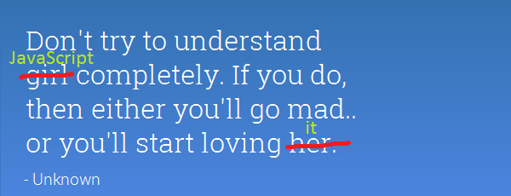
Projects

Slide 8
Development Tools

Slide 9
What can/not/ JavaScript Do?

Slide 10
What can/not/ JavaScript Do?
JavaScript
JavaScript is a scripting language that is run by the JavaScript engine of a web browser and controls the operation of the browser.
Can control DOM events
Can traverse and create HTML elements
Can modify DOM tree
Can access and/or modify browser`s cookies
Can perform asynchronous request, best known as AJAX

Slide 11
What can/not/ JavaScript Do?
JavaScript
turn off JavaScript on your browser and see what happens …..

Slide 12
JavaScript in time

Slide 13
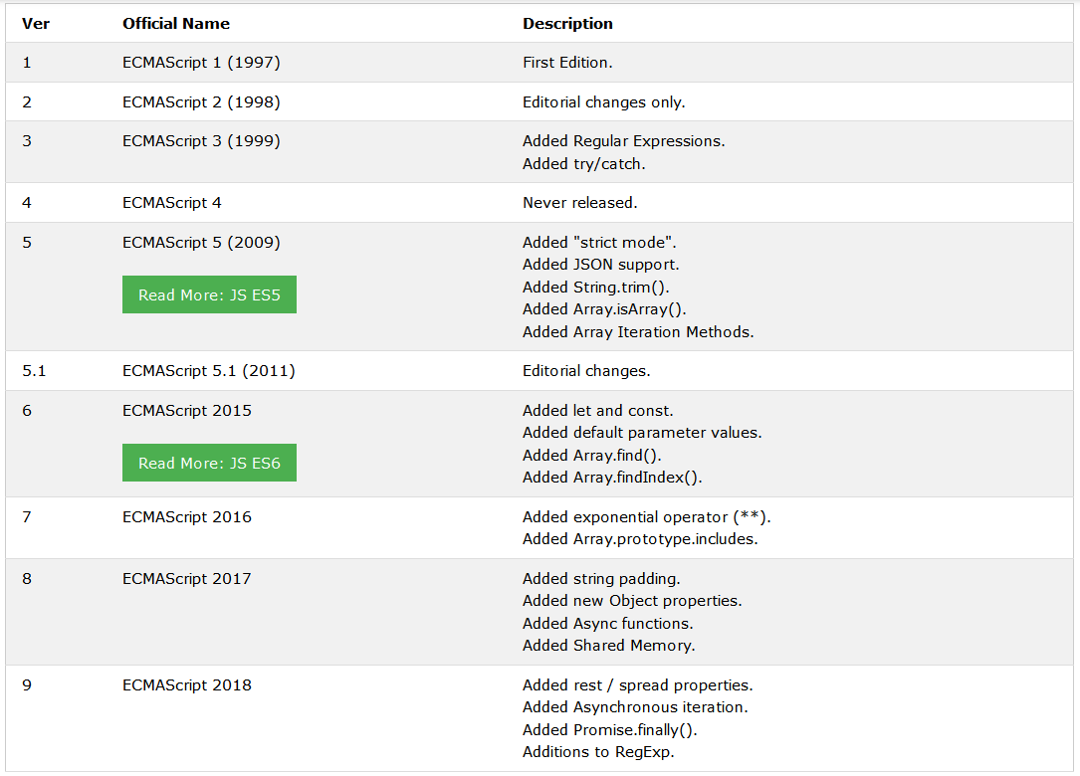
JavaScript in time
JavaScript
Then ECMA Script 2019, 2020, 2021……etc.

Slide 14
How to add JS to your projects?

Slide 15
How to add JS to ….
<body>
<script type="text/javascript">
alert('Hello JavaScript!');
</script>
</body>

Slide 16
Saving uploaded file
Script in the head element
<script type="text/javascript">
//js script goes here;
</script>
External files linked in the head element
<script src="path/to/your/js/file/here" type="text/javascript"></script>

Slide 17
Saving uploaded file
Script in the body element
<script type="text/javascript">
//js script goes here;
</script>
External files linked before the closing body tag
<script src="path/to/your/js/file/here" type="text/javascript"></script>
</body>

Slide 18
JS syntax

Slide 19
Remember
Variables and function names are Case-sensitive
Every declaration should end with ;
Whitespace/tab is ignored
JS code can be carried over to a new line for better readability under certain conditions. / JS will try to add ; if he considers that they are missing☺ /

Slide 20
Remember
Basic rules for naming variables
Can contain letters, numbers, _, $ / don't confuse it with $ in PHP /
Cannot start with a number
Variable names are case-sensitive.
There is no limit to the number of characters
but still DO NOT name them this way - theManOfTheGameThatPlayedTheDayBeforeYesterday! :))
There are special words in JS that cannot be used as variable names - new, this, etc.

Slide 21
Remember
Basic rules for naming variables
6. More popular for JS is the camel casing (taxRate)
if you use underscore for word separation -
be consistent in your code
do not mixed both

Slide 22
Remember
Basic rules - comments
/* Block comments */
//Single-line comments
//Single-line comments
//Single-line comments

Slide 23
Remember
Everything in JavaScript is a predefined object
Every string is a JS object
Every number is a JS object
Every array is a JS object
Every object is a JS object
Every JS object comes with a predefined behaviour - a set of methods/functions and properties that can be used to write JS programs.

Slide 24
Remember
Everything in JavaScript is a predefined object
Often will get an error that says … is not a function ...
If you`ve written the function correctly /no syntax mistake/ that will definitely mean that you are trying to use a function that do not belong to the type of object you have - a function that belongs to a string object and not to a number object for example!

Slide 25
Syntax
Window is a global JavaScript object, that refers to browser window
alert is window`s method
window.alert( "This is a test of the alert method " ) ;
Notice You can omit window, because it is a global object, when calling its alert method
alert( "This is a test of the alert method " ) ;

Slide 26
Remember
How to call JS object method
window.alert()
How to use JS object property
alert(window.location)
will print the URL of the current open page
location is a window property

Slide 27
JS variables

Slide 28
JS variables
After decarning the variable, its subsequent use is without var!
var subtotal; // declares one variable
var investment, interestRate, years; // declares three variables
Declaring a variable and setting a value
var subtotal = 74.00, salesTax;
salesTax = subtotal *.1; //subtotal = 74.00, salesTax = 7.4

Slide 29
JS variables
Set a value with an expression
var subtotal = 74.95; //subtotal = 74.95
subtotal += 20.00; // subtotal = 94.95

Slide 30
JS datatypes

Slide 31
Remember
Datatypes in JS
Like in PHP, we do not explicitly declare the type of data
that the variable will store.
The value we give to the variable can be of type
Integer
Fractional number - float
String
Array
Boolean
NULL

Slide 32
Remember
Datatypes in JS
Specific for JS are undefined and NaN

Slide 33
Remember
Operators in JS
The only difference from PHP is the behaviour
of + operator

Slide 34
JS syntax - operators
console.log( 1 + 1 ) //results is 2
console.log( ‘1’ + ‘1’ ) //results is 11
console.log( ‘1’ + 1 ) //results is 11

Slide 35
JS syntax - operators
Be careful when using JavaScript for calculations with a floating-point numbers
var subtotal = 74.95, salesTax; // subtotal = 74.95
salesTax = subtotal * . 1; //salesTax = 7.495000000000001

Slide 36
Remember
parselnt () & parseFloat ()
parseInt (string)
Converts a string to an integer and returns the resulting value.
If the string is not convertable to a number, returns NaN.
parseFloat (string)
Converts a string to a float and returns the resulting value.
If the string is not convertable to a float, returns NaN.
NaN = not a number

Slide 37
JS syntax - operators
Fastest way to convert a string to a number/to cast to a number is to use +
var subtotal = ‘74.95’; // string
subtotal = +subtotal + 10; //84.95

Slide 38
Remember
typeof()
typeof( var ) check the variable type

Slide 39
JS syntax - typeof( var )
var x = 5;
console.log(typeof(x)); // number
console.log(x); // 5
x = new Number(5);
console.log(typeof(x)); // object
console.log(x); // Number {}
x = null;
console.log(typeof(x)); // object
x = undefined;
console.log(typeof(x)); // undefined

Slide 40
hoisting

Slide 41
hoisting
hoisting
Hoisting is JavaScript's default behavior of moving declarations to the top.
JavaScript Declarations are Hoisted
In JavaScript, a variable can be declared after it has been used.
In other words; a variable can be used before it has been declared.

Slide 42
JS syntax - hoisting
x = 5; // Assign 5 to x
console.log(x) //5
var x; // Declare x

Slide 43
hoisting
hoisting
JavaScript Initializations are Not Hoisted
JavaScript only hoists declarations, not initializations.

Slide 44
JS syntax - hoisting
var x = 5; // Initialize x
var y = 7; // Initialize y
console.log(x);//5
console.log(y);//7
var x = 5; // Initialize x
console.log(x);//5
console.log(y);//undefined
var y = 7; // Initialize y

Slide 45
Remember
Declare Your Variables At the Top !
Hoisting is (to many developers) an unknown or overlooked behavior of JavaScript.
If a developer doesn't understand hoisting, programs may contain bugs (errors).
To avoid bugs, always declare all variables at the beginning of every scope.
Since this is how JavaScript interprets the code, it is always a good rule.

Slide 46
JS syntax - hoisting
var x = 5, y = 7; // Initialize x, y
console.log(x);//5
console.log(y);//7
var x, y; // declare x, y
x = 5; // assign value to x
y = 7; // assign value to x
console.log(x);//5
console.log(y);//7

Slide 49



Trainings @ Vratsa Software
Vratsa Software – High-Quality Education, Profession and Jobs
www.vratsasoftware.com
The Nest Coworking
www.nest.bg
Vratsa Software @ Facebook
www.fb.com/VratsaSoftware
Slack Channel
www.vso.slack.com

